Slide 1
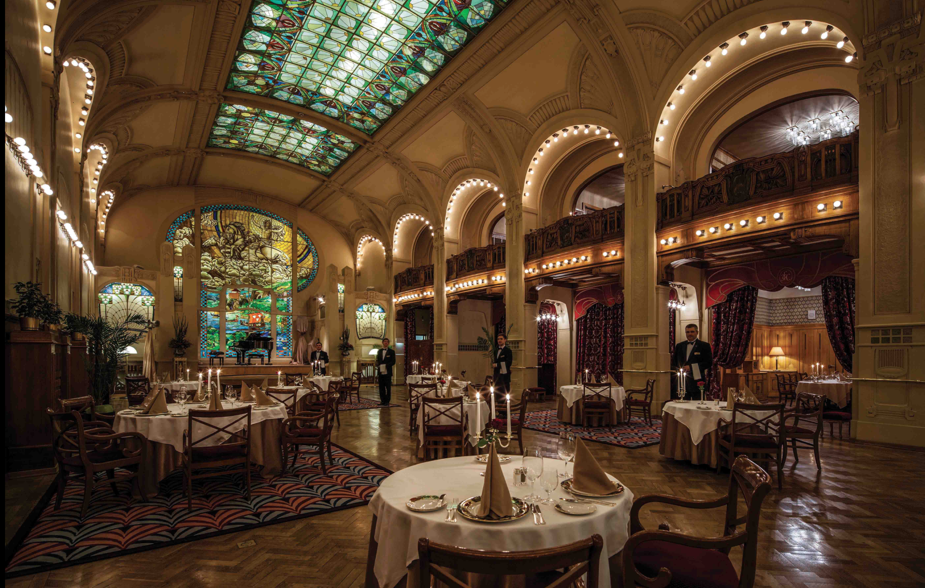

EU restaurants classifier
Module 5 project
N. Kairakbayev
Notes:
Hi!. Let me present you an Executive Summary of Classificator for EU restaurants Price Ranges

Slide 2
Trip Advisor EU Cities Restaurants Dataset
Dataset size
Features after parsing
Samples: 125K
78K – after cleaning
Features: 10 features
160 – after parsing
Ranking ~ 16K unique
Rating ~ 11 unique
Number of reviews ~ 2K unique
Price Range (target) ~ 3 unique
City ~ 31 unique
Cuisine ~ 125 types with different combs for each sample
Source: https://www.kaggle.com/damienbeneschi/krakow-ta-restaurans-data-raw
Notes:
I’ve used dataset provided by Kaggle. It contains over 125k sample with 10 columns inside. I’ve selected the following variables for analysis and usage: Price Range (categorical variable with 3 different values), Ranking, Rating with 11 unique values, Number of Reviews, City and Cuisine style. The cuisine style is provided by list of different style inside, so I’ve made some parsing job for it. In overall, 125 types of cuisine styles were given in the dataset. After some steps in Data Cleaning, I’ve got the dataset with 78K-samples and 159 features, which mainly consists of cities and cuisine styles.

Slide 3

Key Question
What are the factors defining price range?
Key aspects
Features
Validation metrics
Classification algorithm
Benefits for business
Notes:
I’ve chosen Price Range as a target class for the project. Understanding influence of different factors like city or cuisine style on price range gives some useful information for business goals. Important thing is, that all data were taken from real practice, which means that all of given restaurants are working and reflect to market expectations. So, the questions like “what kind of prices should if someone open a restaurant with Asian Cuisine in Amsterdam?”, could be applied on classification results. Important aspect for the further steps are correct choice of features, how to validate forecast results, choose appropriate and robust algorithm and how result of forecasts could be applied for business goals.

Slide 4
Price Ranges
$ (cheap)
$$-$$
(medium)
$$$$
(luxury)
24%
70%
6%
19 005
54 360
4 307
Notes:
As you can see from the plot above, target has 3 classes (cheap, medium and expensive), which are not balanced well. Here, the major class has ~ 70% of total weight. Technically it brings some information, that any forecast accuracy below this level is unappropriate.

Slide 5
TOP3 restaurant statistics
 | CHEAP ($) | MEDIUM ($$-$$$) | LUXURY ($$$$)
TOP3 Cities | London Paris Roma | London Paris Roma | London Paris Barcelona
TOP3 Cuisine Styles | Vegetarian Friendly European Italian | Vegetarian Friendly European Mediterranean | European Vegetarian Friendly Gluten Free
Average Rating | 4.1 | 4.0 | 4.2
Notes:
Here, you can see some interesting TOP-3 typestatistics from the dataset. For example, highest numbers of luxury restaurants are in London, Paris and Barcelona. The most popular cuisine styles for low-priced restaurants are Vegeterian Friendly, European and Italian. And most underrated restaurants are in medium-price segment. This table demonstrate, that some differences between 3 classes could take place, but without ML-models it is hard to reveal it by simple groupby statistics

Slide 6
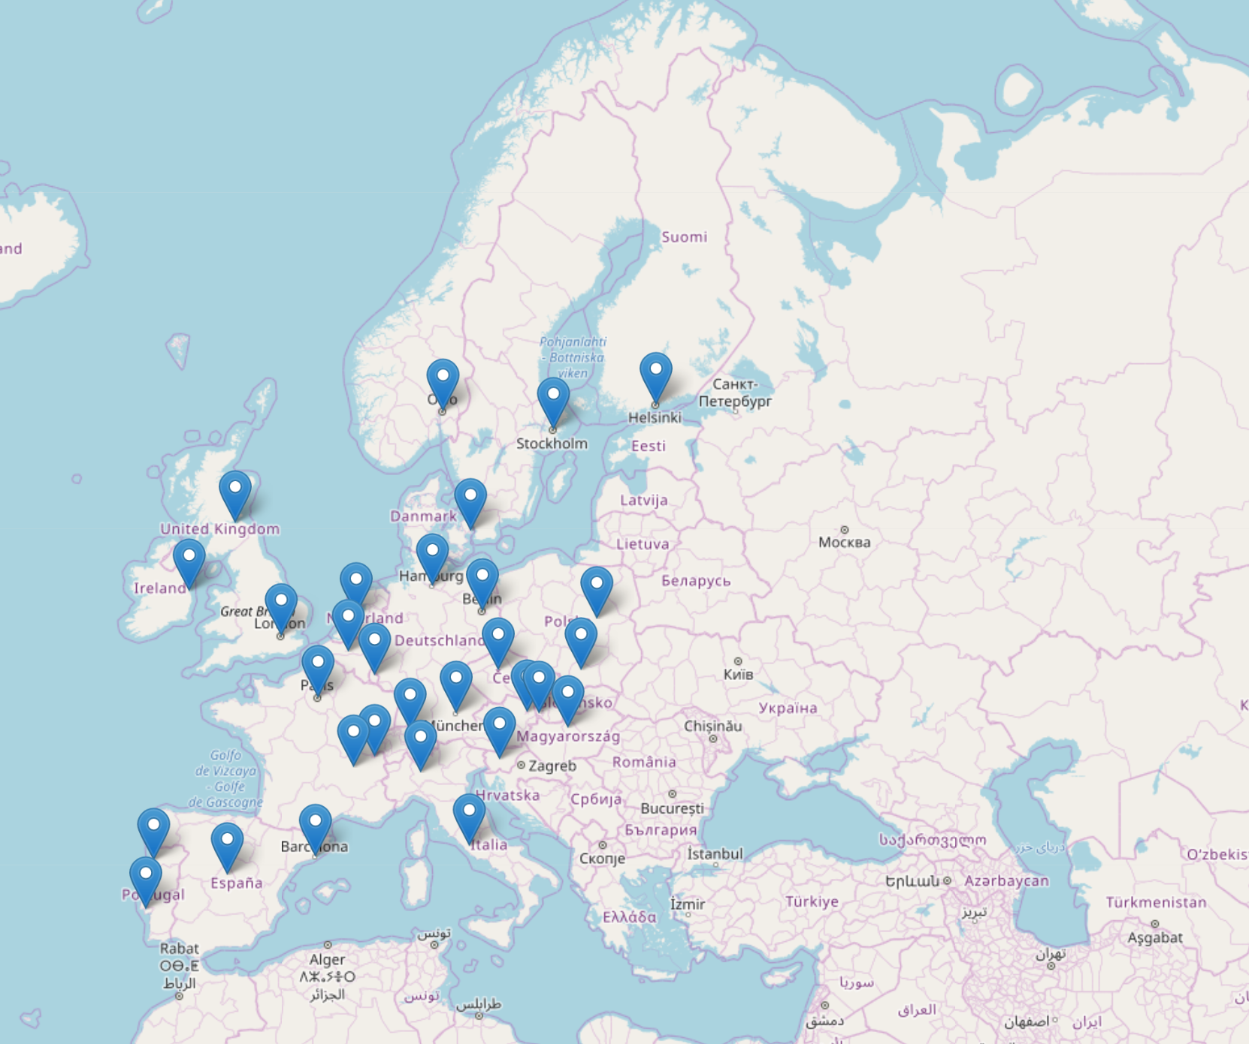
Cities Map
31 cities
23 capitals
24 countries
Notes:
In this slide, I’ve put a EU map with city markers. So you can observe, that the dataset cover almost all Europe except former SU countries and some Eastern European countries

Slide 7
Evaluation Process
Main Metric: Accuracy Score
Data Split:
Kfold validation: for Grid Search
Train-test-split: for Final Model selection
FINAL CLASSIFIER MODEL
Final fit on TRAIN SET and validate on TEST SET
Models (pipes) comparison
Fit Chosen Classifier
Monte-Carlo Simulation on accuracy
GRID SEARCH
only on TRAIN SET with KFOLDS validation
PREPROCESSING
DATA CLEANING
and EDA
PCA
Clustering
Missing data
Parsing cuisine and binning
Visual analysis
Correlation matrices
Notes:
A few words about evaluation process. After Data Cleaning and Exploration, there are 3 main steps for building effective classifier. The first is Data preprocessing, which is important because the dataset is highly sparse and contains a lot of predictors. Here I’ve used Principal Component Analysis and Clustering Analysis. Details on that you can see in Appendix B. The second step’s goal is to define optimal hyperparameters for considered ML-algorithms by using grid-search mechanism. At the final step I’ve run models with optimized params and choose the best one as final classifier.

Slide 8
Applied Models and Methods
B. CLUSTERING
E. Validation
Visual Analysis: 2D KDE PLOT
Cluster models:
Kmeans++
DBSCAN
Metrics:
Calinski-Harabaz
Silhouette score
Kfold – on Grid Search
Train-Test-Split – on Ranking
Pipelines – for process incapsulation
Monte-Carlo – for verify final score
D. Ensemble Models
Random Forest
ADA-Boost
XG-Boost
C. Single Models
E. Ranking metrics
A. PCA
1. KNN
2. Decision Tree
3. SVM-Classifier
4. Logistic Regression
5. Naïve Bayes Classifier
Accuracy Score
F1-score
Correlation Matrix
Break-even VAR portion – 97,5%
Notes:
This slide contains some technical details on applied methods for the valuation steps mentioned before. What I really want to emphasize here is that I’ve ran 8 different types of ML-models for this work showed in C and D.

Slide 9
Models Comparison on Test set
SINGLE MODELS |  | ENSEMBLE MODELS
Model | Accuracy Score | Model | Accuracy Score
KNN | 0.737 | Random Forest | 0.738
Decision Tree | 0.727 | ADA-Boost | 0.736
SVM | 0.739 | XG-Boost | 0.749
Logistic Regression | 0.742
Naïve Bayes | 0.696
Best model: XG-Boost: 0.749 accuracy score on test set 0.800 accuracy score on train set
Notes:
In this slide you can see main results of testing the models. In overall, almost all models have similar accuracy score with maximum difference of 5%. The best model here is XG-Boost model with 0,75 score. The worst model is Naïve Bayes Classifier with 0,7 score which is in red zone.

Slide 10
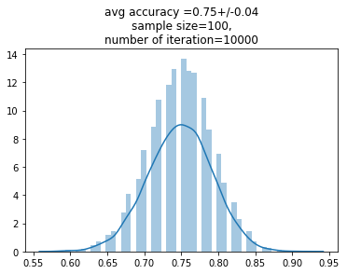
Final Classifier
75%
XG-BOOSTER
Notes:
In this slide you can observe some monte-carlo simulation on the chosen XG-Boost model with average 75% accuracy score.

Slide 11
Business Recommendations
Restaurant Price Ranges could be explained and predicted by its Citiy, Rating, Ranking and Cuisine Styles with moderate level of accuracy (75%)
Classifier Model provides to do Market Segmentation and Research on EU Restaurant business sector
Classifier Model provides scenario inputs for financial evaluation of acquisitions and new restaurant project
Notes:
Current maximum prediction accuracy is 75%. The model provides the ability to make market segmentation in restaurant business located in EU cities. Based on such segmentation it is possible to create investment models for financial evaluation.

Slide 12
Future Work
Find new predictors and samples on missing data and update Classifier
Add NPL analysis on Reviews
Apply Deep Learning methods
Notes:
Of course, the reached accuracy is not very robust, so there are some space to improve the model. First of all, I’ve cut 38% of the dataset because of missing values. Expanding those samples could improve the model power. Also, there is dropped column – REVIEWS, which contains text reviews for restaurants. Such type of variable couldn’t be used in standard ML-models and need to be preprocessed by NLP-methods. And finally, building more complex model from Deep Learning Algorithm also could improve results.

Slide 13
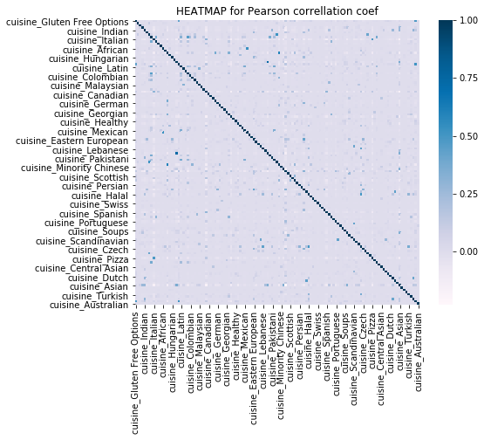
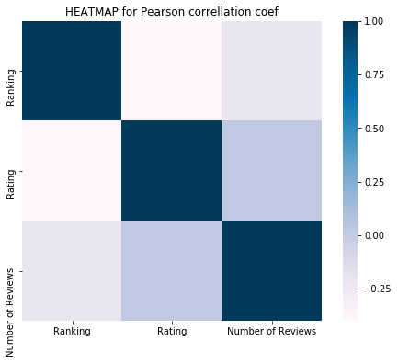
Appendix A: Correlation matrices

Slide 14
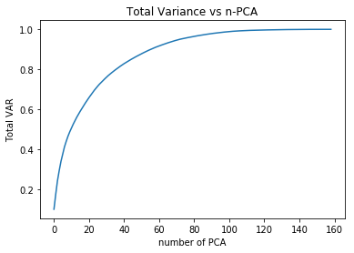
Appendix B: PCA
% of Total VAR | # of PCA
99% | 102
97.5% | 87
95% | 72
90% | 56
80% | 36
Initial X size: 159

Slide 15
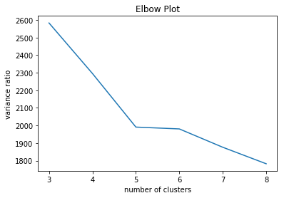
Appendix C: Clustering Analysis
Kmeans++
Silhouette Score – 0. 06
on N = 3
DBSCAN
Silhouette Score:
varies from -0.25 to 0.19

Slide 16
Appendix D: params for single models
KNN
CART
SVM
LogReg
n_neighbors: 50
Algorithm: auto
Criterion: gini
Max_depth: 10
Max leaf nodes: 50
Min sample split: 80
SVM: LinearSVM
C: 1
Max_iter: 100
tol: 1e-12
penalty: l2
Multi_class: ovr
Solver: SAGA
C: 1
tol: 1e-8
penalty: l2
Max_iter: 100

Slide 17
Appendix D: params for ensemble models
Random Forest
ADA-boosting
XG-boosting
Criterion: gini
n_estimator: 15
max_depth: 10
Min_sample_split: 2
Algorithm: SAMME.R
Learning_rate: 0.3
n_estimator: 1000
Booster: gbtree
n_estimator: 100
learning_rate: 0.1
Max_depth: 7
Base_score: 0.75
reg_lambda: 1

